Slide 1
Topic Modeling on Amazon Review
🎹👚📱🍕🏀💻🎮👼
Anak Agung Ngurah Bagus Trihatmaja, Xiaomeng Peng, Ayush Bhandari, Anupam Gupta

Slide 2
Introduction
Objective:
Find the category of the products on Amazon, using LDA, based on the review
Dataset:
Amazon Fine Food Review dataset [1]
Amazon review dataset from various categories [2]
Pre-processing:
Remove stopwords and lemmatization,
convert to bi-gram
convert to bag-of-words model
Split the dataset into development, training, and test dataset
http://snap.stanford.edu/data/web-FineFoods.html
R. He, J. McAuley. Modeling the visual evolution of fashion trends with one-class collaborative filtering. WWW, 2016
J. McAuley, C. Targett, J. Shi, A. van den Hengel. Image-based recommendations on styles and substitutes. SIGIR, 2015

Slide 3
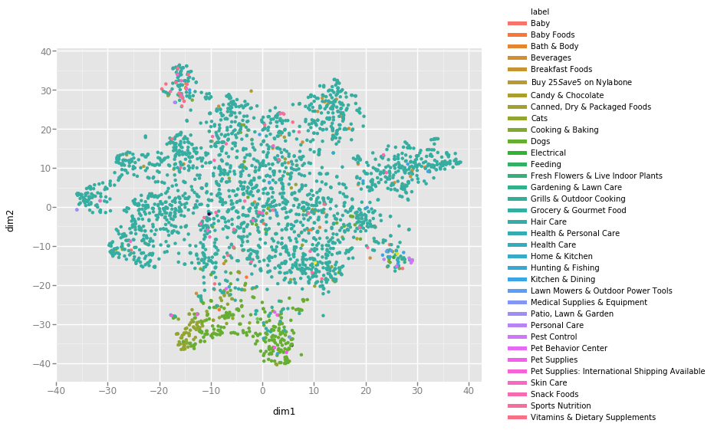
LDA on Amazon Fine Foods Dataset: T-SNE Representation
Problems of this dataset:
Labels are not available. We have to use labels from different sources
Data Imbalanced. Within 568454 reviews, ~ 82% of them from Grocery and Gourmet Food.

Slide 4
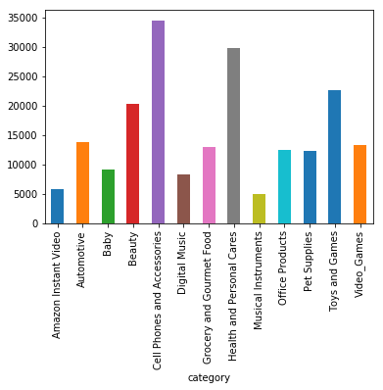
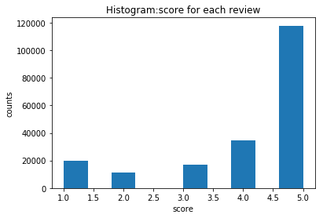
Exploratory Review Data Analysis
Total 200,152 reviews on the Amazon Review Datasets
Balanced categories
Majority are positive reviews
# of reviews for each category
# of reviews for each score
‹#›
Notes:
slides 2-5: 1.5 minutes

Slide 5
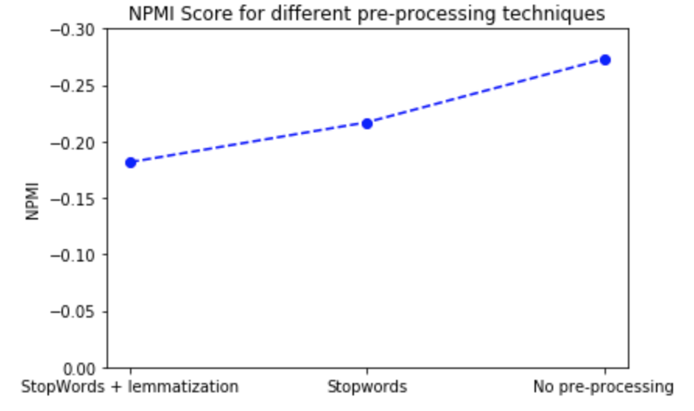
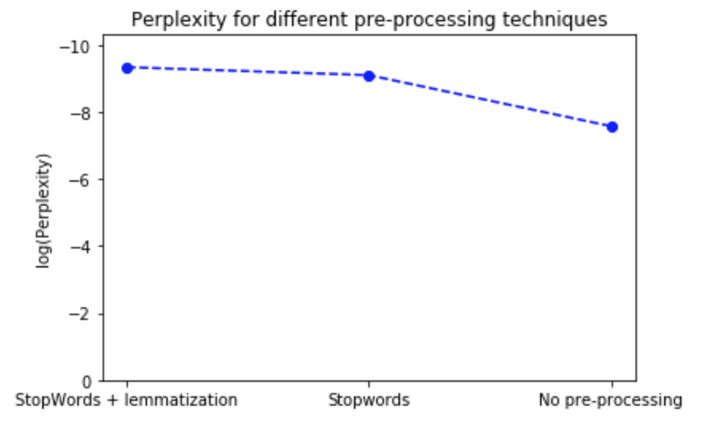
Pre-processing Analysis
Lemmatization :
Aims to remove inflectional endings to get the root word known as lemma.
Groups together different inflected forms so they can be evaluated as a single item.
E.g. walks, walking, walked would be converted to walk.
Stopwords :
Commonly used words in any language, which provide no real meaning to the context of the document.
E.g. but, if, or, because, as, at, the, me, myself, until.
Notes:
1 minute

Slide 6
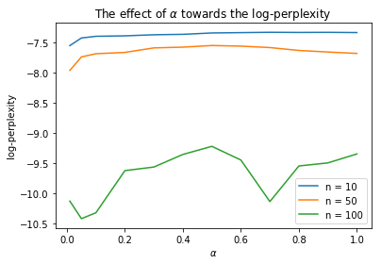
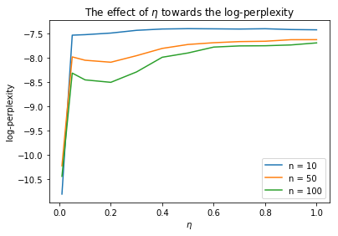
Sensitivity Analysis: Finding 𝛂 and 𝛈
LDA on training dataset and measure the log-perplexity on the test dataset.
Lowest per-word log-perplexity is where 𝛂 = 0.01 and 𝛈 = 0.01 (with fixed 𝛂 = 0.01).

Slide 7
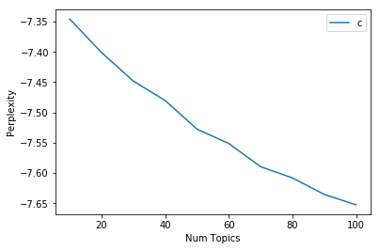
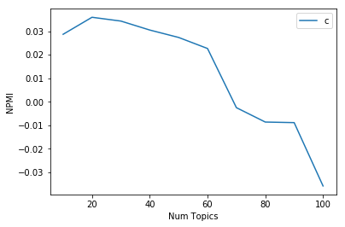
Finding Optimal Number of Topics
Number of topics vs log-perplexity
Number of topics vs NPMI
log-perplexity
Perplexity often not correlated with human judgement [3]
Choose the number of topics based on Normalized Pointwise Mutual Information (NPMI)
3. https://papers.nips.cc/paper/3700-reading-tea-leaves-how-humans-interpret-topic-models.pdf
Notes:
1.5 minutes for slide 7-8

Slide 8
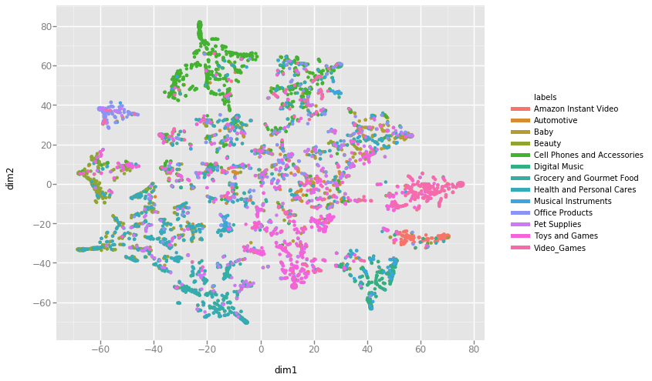
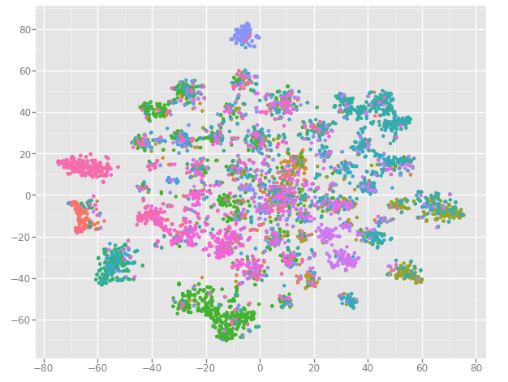
LDA on Amazon Review Dataset
T-SNE after LDA with 20 topics
T-SNE after LDA with 100 topics

Slide 9
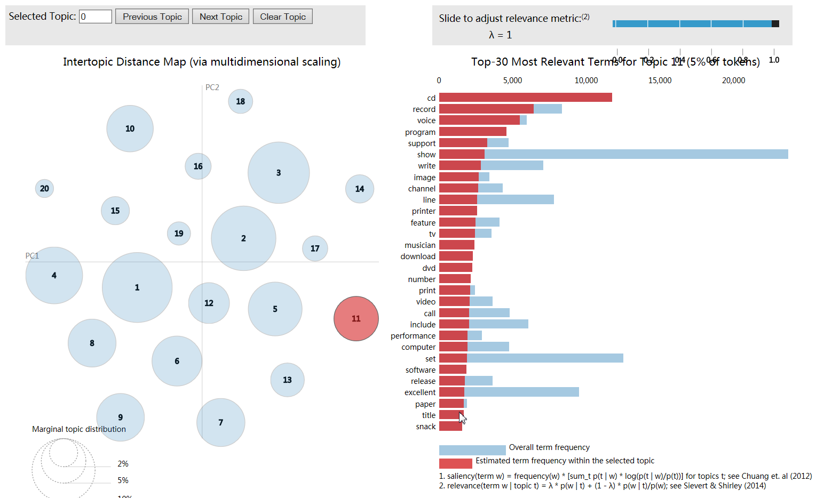
Top words of 20 topics
Possible related to Music

Slide 10
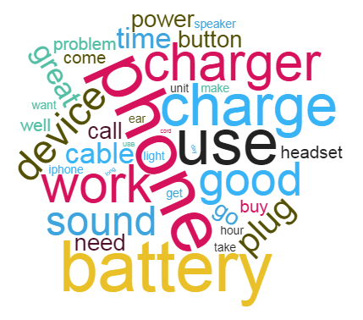
Review Example
Review | Category: Cell Phones and Accessories
I use this desk headset every day in both my office and my home. I love the way it feels. I love the clarity when I talk into the phone. I love the fact that I can see my screen and carry on a private conversation. I have an iphone 4 and I really like the button in the middle of this headset because it allows me to hang up, or answer the phone from the headset... hold that same button down and it will pull up voice control and I can ask my phone to call someone for me. Click the button lightly and it will pick up on the last thing playing on itunes. This product is easy to use, designed with the consumer in mind and most of all it makes it enjoyable to talk on the phone again. I love the retro feel and look. The fact that I get a little less radiation because I'm holding this headset to my head instead of my phone is just an added bonus.
Topics | 13 | 0 | 1 | 9 | 7
Probabilities | 0.580276 | 0.149048 | 0.106289 | 0.096238 | 0.065949

Slide 11
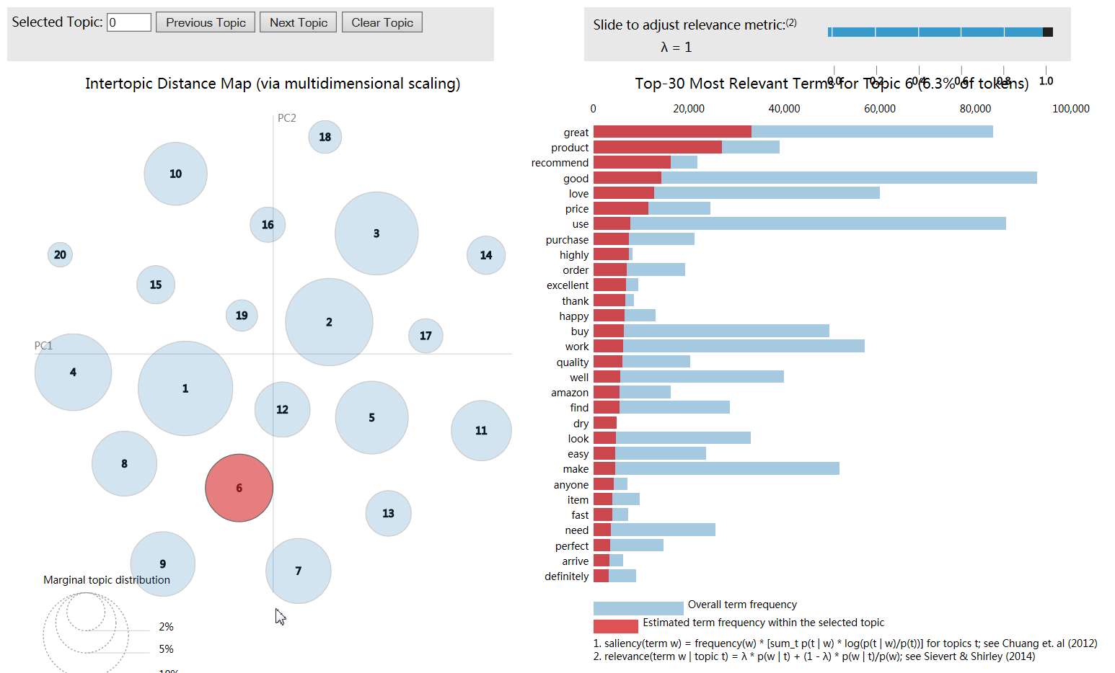
Impact of Good Reviews
Majority of reviews are positive

Slide 12
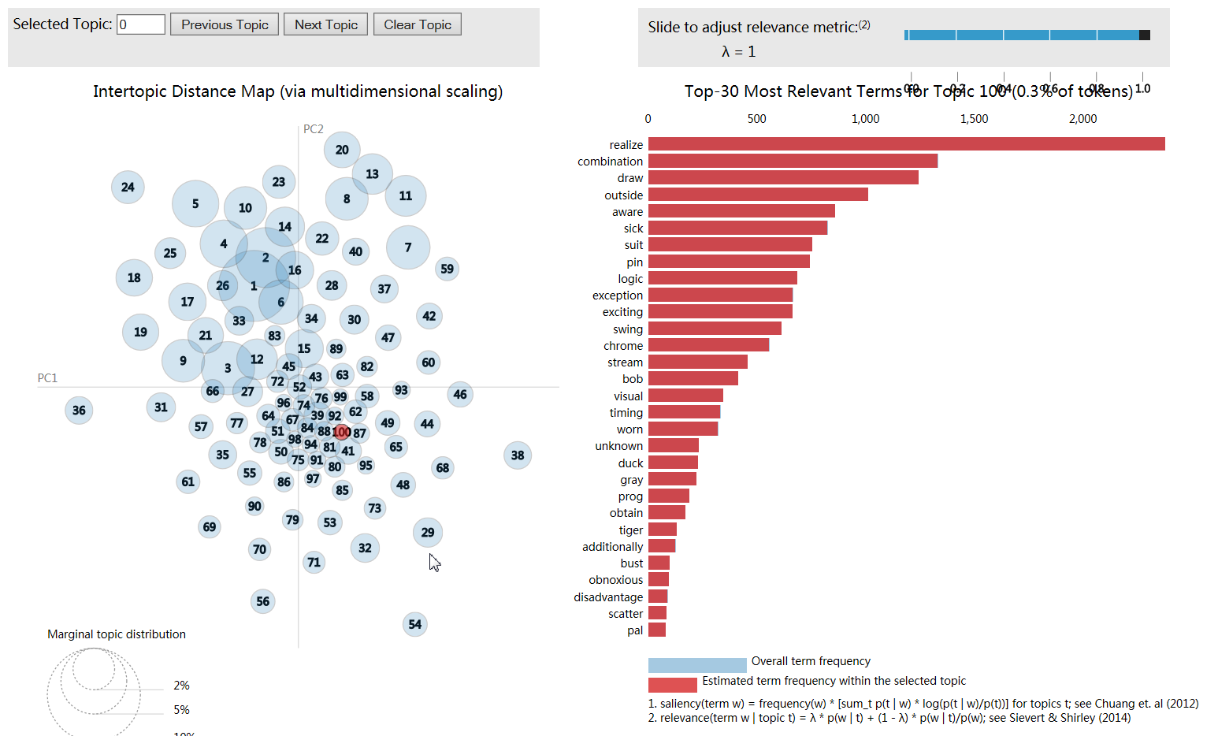
Top words of 100 topics

Slide 13
LDA as dimensionality reduction for Logistic Regression
65%
accuracy on test dataset with 100 topics
59%
accuracy on test dataset with 20 topics

Slide 14
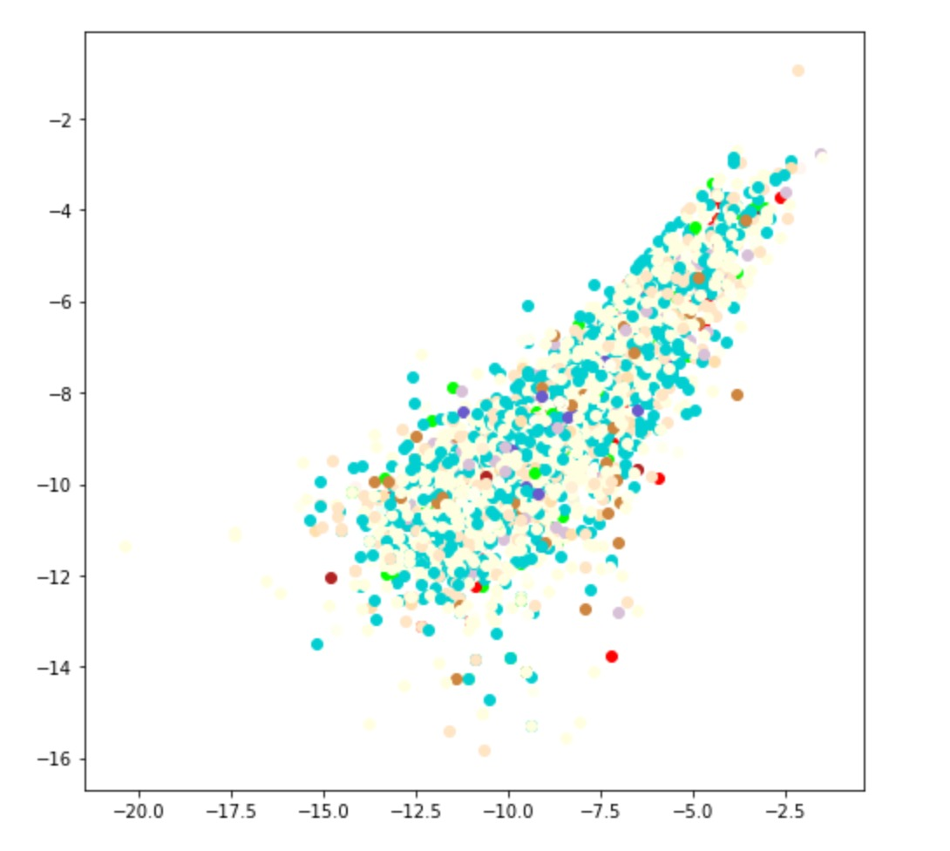
Clustering result compare with PCA
Reduced to 2 dimensions using PCA, clustering using K-means
Most of the products are assigned the same reduced dimensions after PCA and are overlapping with each other.

Slide 15
Conclusion
We need balanced data is to effectively find the topics of the documents
Pre-processing affect the quality of LDA
NPMI has largest correlation to human topic coherence ratings[4]
4. Röder, Michael, Andreas Both, and Alexander Hinneburg. "Exploring the space of topic coherence measures." Proceedings of the eighth ACM international conference on Web search and data mining. ACM, 2015.

Slide 16
Thank you

